Slide 1
YOU LIKE TO BE ACTIVE, YOU ARE A PROBLEM SOLVER, AND YOU LOVE ADVENTURE.
WHAT I DO
I operate drones to take videos of whales in the ocean, explore and map out national parks, keep track of wildlife populations, and find people who are illegally killing wild animals.
WHY I ENJOY IT
I get to travel to different places, solve problems, work by myself outside, and operate cutting-edge technology.
WHAT I DO
I catch and arrest people called poachers who illegally hunt or capture wild animals, like poachers who kill elephants for their ivory tusks.
WHY I ENJOY IT
I went through difficult training for this job, and only the elite trainees were chosen to be rangers, so it is a great honor for me to be trusted with such an important and dangerous job.
WHAT I DO
I keep forests healthy by preventing, managing, and putting out forest fires.
WHY I ENJOY IT
My job is very challenging and exciting because I may hike into a fire one day,
get dropped off by a helicopter another
day, or stay up all night protecting entire neighborhoods from forest fires.

Slide 2
YOU LIKE TO BE ACTIVE, YOU ARE A PROBLEM SOLVER, AND YOU ARE VERY OBSERVANT.
WHAT I DO
I install solar panels on homes and buildings to power them with renewable energy from the sun.
WHY I ENJOY IT
I love working with my hands, assembling and building things that are useful, and calculating how to make the most efficient solutions.
WHAT I DO
I help people in my neighborhood grow their own food in our community garden.
WHY I ENJOY IT
I am feeding my community with fresh vegetables and fruits, making my neighborhood more beautiful, and helping wildlife like hummingbirds and butterflies with the plants they need to thrive.
WHAT I DO
I work at a wildlife hospital where I take care of sick and orphaned wild animals.
WHY I ENJOY IT
It gives me a lot of joy to care for injured animals, especially the baby squirrels and birds, and it makes me happy to release them back into the wild when they are healed.

Slide 3
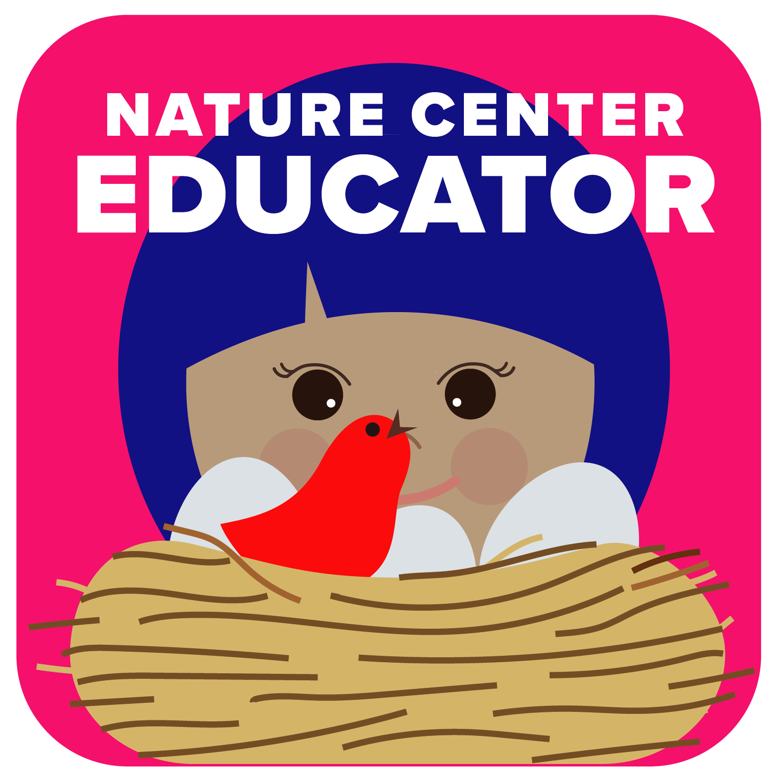
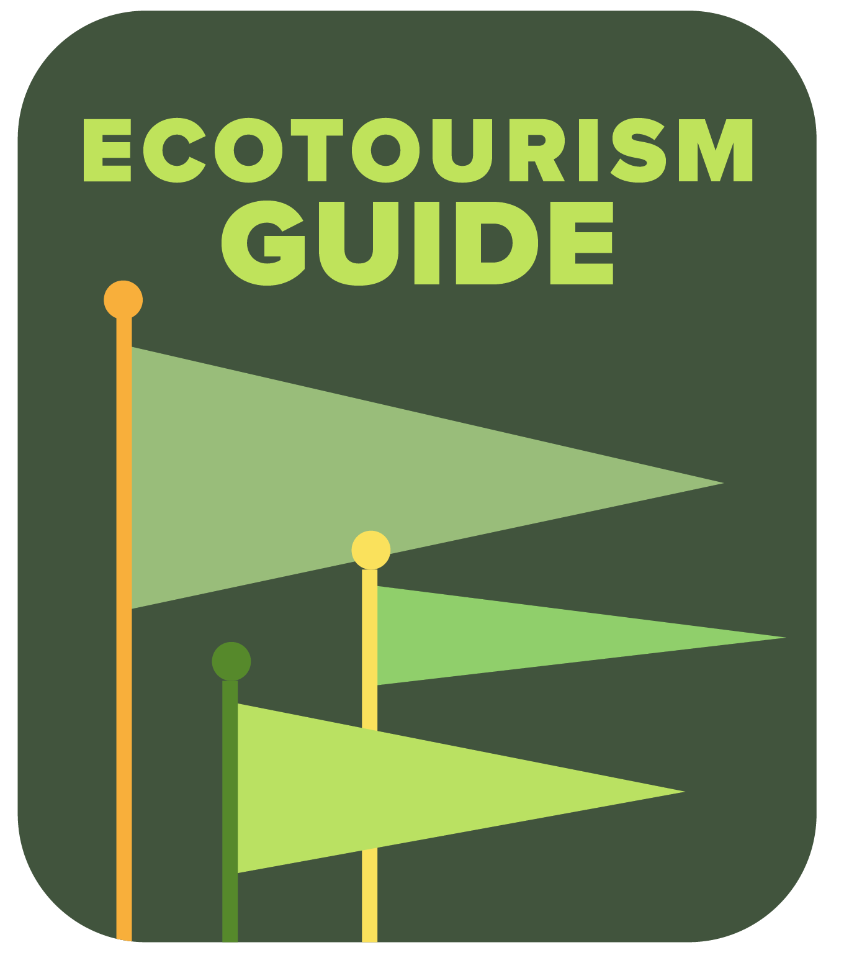
YOU LIKE TO BE ACTIVE, YOU ARE GOOD AT TELLING STORIES, AND YOU LOVE ADVENTURE.
WHAT I DO
I teach people about nature and create special outdoor classes for adults, families, and school children.
WHY I ENJOY IT
I’m part scientist, part teacher, and part entertainer. It’s a perfect combination for me!
WHAT I DO
I take groups of tourists into natural areas, tell them what they are seeing, and make sure they have a safe, fun, and enriching experience.
WHY I ENJOY IT
I like the surprise of never knowing what wildlife we will see when I take people on safaris and bird watching trips, and it means a lot to me that my work helps to support wildlife and our local communities.
WHAT I DO
I use cameras to capture those rare moments when a photograph might inspire someone to see wildlife and nature in a new way.
WHY I ENJOY IT
I love my work because it’s creative, I get to use technology, and I am motivated by the challenge of being patient enough to get that perfect photo of a wild animal in its natural habitat.

Slide 4
YOU LIKE TO BE ACTIVE, YOU ARE GOOD AT TELLING STORIES, AND YOU ARE VERY OBSERVANT.
WHAT I DO
I convince lawmakers and citizens to take actions that will benefit our climate, reduce pollution, and ensure clean air and water.
WHY I ENJOY IT
I love persuading people to protect our planet and being able to speak up and be a leader in my community.
WHAT I DO
I convince everyday people in my community to get involved in environmental projects like protecting our local parks and starting composting programs.
WHY I ENJOY IT
I have always been that person who is ready to stand up when there is an injustice, and this is a job where I can fight for my community and our right to a safe and clean environment.
WHAT I DO
I sell products that help companies get rid of chemicals that are bad for the environment.
WHY I ENJOY IT
I’m an outgoing person who likes to talk with a lot of people, and I am always interested in finding ‘green’ solutions to clean up the world’s environmental problems.

Slide 5
YOU ARE A DEEP THINKER, YOU ARE A PROBLEM SOLVER, AND YOU LOVE ADVENTURE.
WHAT I DO
Perhaps you’ve heard of lawyers who defend clients. My client happens to be
the environment, wildlife, and lands. Working within the legal system, I defend and protect nature.
WHY I ENJOY IT
I love using my mind to protect what I care about and spending my days researching, thinking, strategizing, and debating.
WHAT I DO
I invent better ways to clean water, recycle trash, protect our oceans, and clean the air. I have already started working on a robot that can float above coral reefs in the ocean to collect data on water quality.
WHY I ENJOY IT
I love having such a creative job. I can’t remember a time when I wasn’t taking things apart to see how they worked and putting them back together to create something new.
WHAT I DO
I design fashionable clothing that has a low impact on the environment and uses fabric made from materials that are recycled and repurposed.
WHY I ENJOY IT
I love that I can spend every day designing beautiful clothing and pushing boundaries in fashion, and my buyers can feel proud that their purchases don’t harm the environment.

Slide 6
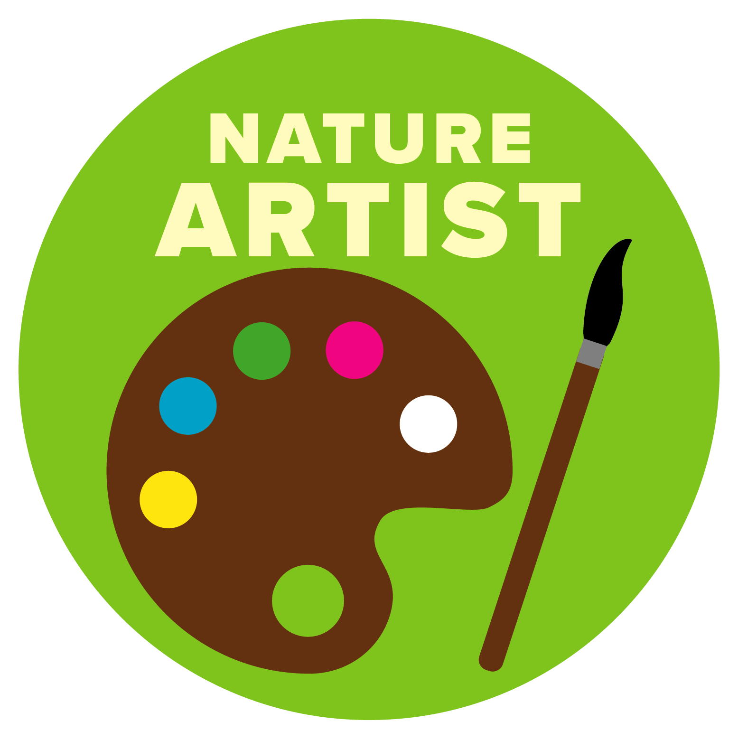
YOU ARE A DEEP THINKER, YOU ARE A PROBLEM SOLVER, AND YOU ARE VERY OBSERVANT.
WHAT I DO
I express my love of nature and wildlife by creating landscape paintings. I mostly set up my easel in the places I’m painting, but sometimes I finish a piece in my studio.
WHY I ENJOY IT
What I love most about being an artist is that the joy I feel when I’m painting is passed on to people who see my work, and that inspires them to become more aware and appreciative of nature.
WHAT I DO
I’m a doctor for wild animals like lions, elephants, and giraffes. I work closely with wildlife managers and zoo biologists to prevent the spread of diseases and ensure that animals are healthy.
WHY I ENJOY IT
I enjoy the challenge of solving mysteries, such as why certain diseases are affecting wild animals, and it means a lot to me when my work can help the survival of endangered species.
WHAT I DO
I’m a scientist who studies wild animals to learn more about their biology and how to better protect them.
WHY I ENJOY IT
It is fun to pay close attention to clues about wildlife, from hiking in the mountains looking for animal tracks to searching the forest floor for clues in animal poop. Nothing is too weird or gross for me.

Slide 7
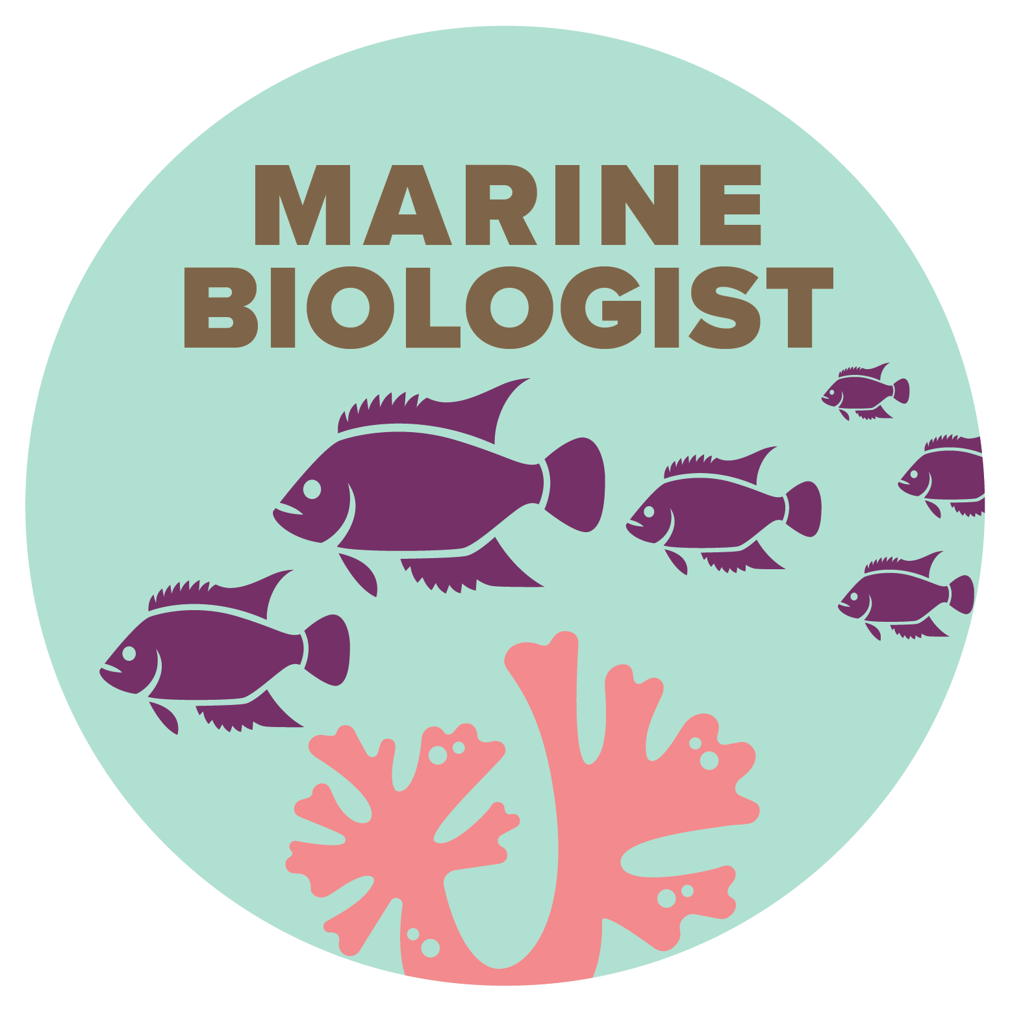
YOU ARE A DEEP THINKER, YOU ARE GOOD AT TELLING STORIES, AND YOU LOVE ADVENTURE.
WHAT I DO
I write news stories about the environment, which involves a lot of researching, asking questions, and interviewing all sorts of people.
WHY I ENJOY IT
I get to be where the action is when an environmental news story develops, and
I enjoy explaining things so that more people can understand how to care for
our environment and each other.
WHAT I DO
I make wildlife documentaries, which are real-life films of animals living in nature, with a narrator describing what the animals are doing and what their behaviors mean.
WHY I ENJOY IT
I get to travel to amazing places and tell visual stories about the places and creatures that fascinate me, and my stories have the potential to reach many people for years to come.
WHAT I DO
I am a scientist who studies the ocean,
and a typical day for me includes diving underwater around a coral reef or making observations of fish from my boat.
WHY I ENJOY IT
I love when I discover something new, especially when my discoveries can help protect ocean life.

Slide 8
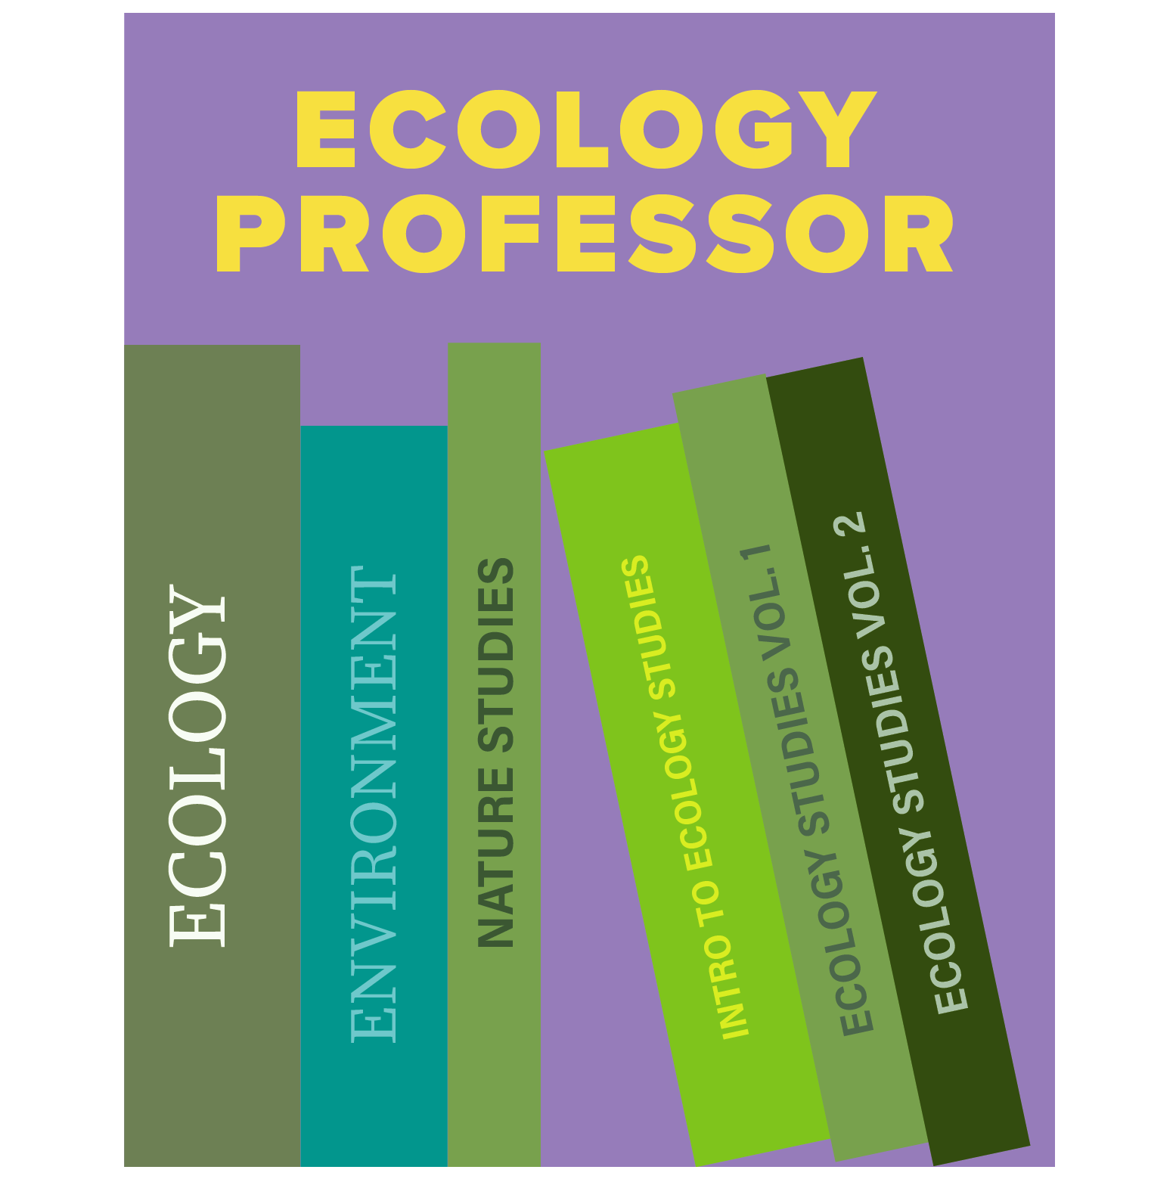
YOU ARE A DEEP THINKER, YOU ARE GOOD AT TELLING STORIES, AND YOU ARE VERY OBSERVANT.
WHAT I DO
I write books and poetry about wildlife, conservation, new scientific discoveries, and what people can do to protect nature.
WHY I ENJOY IT
I like being able to learn new things about nature and share that information with others.
WHAT I DO
I work as an educator in my city’s science museum. We have exhibits about everything from rocks to dinosaurs to modern animals living in our area.
WHY I ENJOY IT
I enjoy figuring out how to explain things to people and what information might spark a lifelong interest in science, nature, and conservation.
WHAT I DO
I am a scientist who teaches college students about the subject of ecology, which deals with how living things interact with their environment.
WHY I ENJOY IT
I like the challenge of explaining the complex rules of nature and making them fun and exciting for my students.

